Slide 1
Informed Consent
in Idaho
Melissa M. Starry

Slide 2
Important information
This presentation is similar to any other seminar designed to provide general information on pertinent legal topics. The statements made and any materials distributed as part of this presentation are provided for educational purposes only. They do not constitute legal advice nor do they necessarily reflect the views of Holland & Hart LLP or any of its attorneys other than the speakers. This presentation is not intended to create an attorney-client relationship between you and Holland & Hart LLP. If you have specific questions as to the application of the law to your activities, you should seek the advice of your legal counsel.
All Presentations and Other Materials © Holland & Hart LLP 2015

Slide 3
What we’ll cover
Informed consent for treatment
Refusal of consent for treatment
Advance directives

Slide 4
Informed Consent

Slide 5
Consent: General Principles
Must have valid consent for treatment.
If patient lacks capacity to consent:
Check for advance directive, or
Obtain consent from authorized representative.
In an emergency and no time to obtain consent, provide necessary care.
Must provide sufficient information to ensure that the consent is informed.

Slide 6
Consent: General Principles
Medicare Hospital Conditions of Participation
“The patient has the right to participate in the development and implementation of his or her plan of care.”
“The patient or his or her representative … has the right to make informed decisions regarding his or her care. The patient's rights include being informed of his or her health status, being involved in care planning and treatment, and being able to request or refuse treatment.”
“The patient has the right to formulate advance directives and to have hospital staff and practitioners who provide care in the hospital comply with these directives…”
(42 CFR 482.13(b)(2))

Slide 7
Consent: Liability
Failure to obtain consent =
Lack of informed consent tort
Battery
False imprisonment
Malpractice
Other?
Penalties
Criminal fines
Prison
Civil damages
Adverse licensure action
Informed consent is a defense

Slide 8
Where might a court informed consent missing?
Treat patient who lacks capacity to consent to their own care (e.g., patient medicated, intoxicated, underage, etc.).
Ignore patient’s prior wishes or decisions (e.g., provides care contrary to advance directive).
Continues treatment even though patient has objected or withdraws consent.
Provides treatment that exceeds scope of consent.
Fails to inform patient of sufficient info reasonably necessary to enable patient to make an informed decision.
Fails to effectively communicate with patient so as to convey or receive informed consent (e.g., limited English proficiency, disability, etc.).

Slide 9
Medical Consent and Natural Death Act (IC 39-4501 et seq.)

Slide 10
Capacity
“Any person who comprehends the need for, the nature of and the significant risks ordinarily inherent in, any contemplated … health care, treatment or procedure is competent to consent thereto on his or her own behalf.”
“Any health care provider may provide such health care and services in reliance upon such a consent if the consenting person appears to the health care provider securing the consent to possess such requisite comprehension at the time of giving consent.”
(IC 39-4503, emphasis added)

Slide 11
Capacity: Minors
Can minors consent to their own care?

Slide 12
Capacity: Minors
Consent for the furnishing of health care to [1] any person who is not then capable of giving such consent or [2] who is a minor may be given or refused by the following, provided that the surrogate decision maker shall have sufficient comprehension as required to consent to his or her own health care:
Court appointed guardian.
Person named in living will and durable power of attorney.
Spouse.
Adult child.
Parent.
Delegation of parental authority per IC 15-5-104.
Relative.
Any other competent person representing himself or herself to be responsible for health care.
(IC 39-4504(1))

Slide 13
Capacity: Minors
Conservative approach: do not allow minor to consent to their own care unless:
Minor is emancipated.
Statute authorizes minor to consent to their own care.
Statute authorizes care regardless of consent.
Mature minor doctrine might apply, but be careful.

Slide 14
Minor’s Capacity: Emancipation
Minor is probably emancipated and able to consent to their own healthcare if:
Married or has been married (see IC 18-604(3))
In armed forces (see IC 18-604(3))
Living on own and self-sufficient (see IC 66-402(6))
Court declares them emancipated (see IC 16-2403(1))
Must still satisfy the basic test, i.e., be able to “comprehend the need for, the nature of and the significant risks ordinarily inherent in, any contemplated … health care…”
(IC 39-4503)

Slide 15
Minor’s Capacity: Emancipation
What about pregnant minors?

Slide 16
Minor’s Capacity: Emancipation
Pregnancy is probably not an emancipating event.
“Capacity to become pregnant and capacity for mature judgment concerning the wisdom of bearing a child or having an abortion are not necessarily related.”
(IC 18-602)
“To protect minors from their own immaturity”, abortions for “pregnant unemancipated minors” generally require:
Parental/guardian consent, or
Judicial finding that minor is mature and capable of giving informed consent.
(IC 18-602, 18-609A)
If pregnancy were an emancipating event, you would not need parental consent for abortion.

Slide 17
Minor’s Capacity: Emancipation
What about after a minor parent gives birth?
Does minor parent have authority to consent for baby?
Does minor parent have authority to consent for herself?
What about the minor father?
Consent for the furnishing of health care to [1] any person who is not then capable of giving such consent or [2] who is a minor may be given or refused by, among others, a parent.
Provided that the surrogate decision maker shall have sufficient comprehension as required to consent to his or her own health care.
(IC 39-4504(1))

Slide 18
Minor’s Capacity: Statutes Allow Minor Consent
Emergency medical exam and stabilizing treatment in hospital.
(HHS Interpretive Guidelines to 42 CFR 489.24)
Examinations, prescriptions devices, and info regarding contraceptives if practitioner determines that minor has sufficient intelligence and maturity to understand the nature and significance of treatment.
(IC 18-603)
Drug treatment or rehab.
If minor is age 16 or older, cannot notify parents without minor’s consent.
(IC 37-3102)

Slide 19
Minor’s Capacity: Statutes Allow Minor Consent
Age 14: testing or treatment for reportable infectious or communicable disease.
(IC 39-3801)
Age 14: hospitalization for observation, evaluation and treatment for mental condition.
Treating facility must notify parents
(IC 66-318(a)(2))
Age 17: unpaid blood donations.
(IC 39-3701)

Slide 20
Minor’s Capacity: Mature Minor Doctrine
In other states, minors with sufficient maturity may consent to their own care.
No Idaho cases.
Idaho statutes are ambiguous.
IC 39-4503 states “any person” of sufficient comprehension may consent to or refuse their own care. See also IC 18-603 and 18-609A.
IC 39-4504 identifies those who may consent for minors.

Slide 21
Minor’s Capacity: Mature Minor Doctrine
At some point, constitutional rights or parenthood may be decisive.
Individual probably has fundamental right to make decisions about themselves and their offspring.
But we don’t have any Idaho cases regarding this right now.
Until then, you may want to consider what Idaho judge or jury would think…

Slide 22
Minor’s Capacity: Mature Minor Doctrine
Risks of allowing minor to consent to their own care absent express statute or case:
May expose practitioner to liability if court concludes minor lacked capacity to consent.
May limit ability to disclose info to parents.
May limit ability to obtain payment.

Slide 23
Minor’s Capacity: Mature Minor Doctrine
As general rule, practitioners should require parental consent unless minor is emancipated or statute applies.
If rely on mature minor doctrine, be careful; consider, and document relevant factors.
Age
Maturity, intelligence and understanding per IC 39-4503
Nature of treatment, including risks

Slide 24
Authority: Surrogates
“Consent for the furnishing of … health care … to [1] any person who is not then capable of giving such consent … or [2] who is a minor may be given or refused in the order of priority set forth hereafter; provided
that the surrogate decision maker shall have sufficient comprehension as required to consent to his or her own health care, and
the surrogate decision maker shall not have authority to consent to or refuse health care contrary to such person's advance directives, POST or wishes expressed by such person while the person was capable of consenting to his or her own health care.”
(IC 39-4504(1))

Slide 25
Authority: Surrogates
Surrogate decision makers
Court appointed guardian.
Person named in living will and durable power of attorney if conditions triggering authority are satisfied.
Spouse.
Adult child.
Parent.
Delegation of parental authority per IC 15-5-104.
Relative representing himself as appropriate responsible person to act under the circumstances.
Any other competent person representing himself or herself to be responsible for health care.
(IC 39-4504(1))

Slide 26
Authority: Surrogates
Surrogate who, in good faith, gives consent for another is immune from civil liability.
Practitioner who, in good faith, obtains consent from apparently competent patient or other authorized surrogate is immune from civil liability.
(IC 39-4504(2)-(3))

Slide 27
Authority: Emergency
Consent is implied in an emergency. (IC 39-4504(1))
“Substantial likelihood of his or her life or health being seriously endangered by withholding or delay in the rendering of … health care…”
“and the person…has not communicated and is unable to communicate his or her treatment wishes…”
Providers immune from liability in an emergency if acted in good faith with no knowledge of facts negating consent. (IC 56-1015)

Slide 28
Form of Consent
“It is not essential to the validity of any consent … that the consent be in writing or any other specific form of expression.”
(IC 39-4507)
Under Idaho law, consent may be:
Implied
Oral
Written
Other laws or payor standards may require documented consent, e.g.,
COPs 42 CFR 482.13(b), 482.24(c)(2)(v), 42 CFR 482.51(b)(2); 485
Joint Commission RC.02.01.01
If it’s in writing, it’s presumed to be valid! (IC 39-4507)
The more significant the treatment, the greater the need to document informed consent.

Slide 29
Form of Consent: Suggestions
Specific consent: significant treatment
Communication about specific treatment.
Pre-published forms may help provide info and document consent, but beware undue reliance.
Medical record notes confirming that elements of consent satisfied, e.g., patient competency, discussion, understanding, questions/answers.
General consent: upon registration
Covers basic treatment activities, e.g., physical exams, basic medications, diagnostic tests, labs and pathology, photos, etc.
Implied consent
Invasiveness and Risks

Slide 30
Form of Consent: Consent Form
Name and signature of patient or legal representative.
Name of the provider.
Name of treatment or procedures.
Name of all practitioners performing the procedure and individual significant tasks if more than one practitioner.
Risks and benefits.
Alternative procedures and treatments and their risks .
Date and time consent is obtained.
Statement confirming procedure was explained to patient.
Signature of person witnessing the consent.
Name and signature of person who explained the procedure to the patient or guardian.
(See CMS SOM to 42 CFR 482.24(c)(2)(v)).

Slide 31
Informed Consent
For valid consent: inform the patient of [1] the need for, [2] the nature of, and [3] the significant risks involved in the care to be provided.
Ask yourself: “What info would other practitioners in community give?”
For valid consent, provider should disclose information that would ordinarily be given under the same or similar circumstances, by a like health care provider of good standing practicing in the same community. As used in this section, the term "in the same community" refers to that geographic area ordinarily served by the licensed general hospital at or nearest to which such consent is given.
(IC 39-4506)

Slide 32
Informed Consent
Informed Consent = Communication | Consent form = Documentation
Practitioner communicates info relevant to treatment Patient understands the material facts, e.g., benefits, risks, and likely consequence of the proposed treatment and alternatives. Patient makes informed decision to consent or refuse treatment. | Supplements oral or other info given by the practitioner. Documents that the communication process took place, e.g., that practitioner communicated relevant info, patient understood info, and patient made voluntary, informed decision.

Slide 33
Informed Consent
Ensure that patient understands.
Evaluate whether patient is in a condition so as to be able to process relevant info.
Speak at the patient’s level of understanding.
Beware language barriers.
Discrimination statutes may require interpreters, translators, or communication aids.
Supplement oral communications with written or visual material and documentation.
Give the patient an opportunity to ask questions and receive answers.

Slide 34
Informed Consent
Informed consent typically requires disclosure of:
Nature of proposed treatment.
Potential benefits, risks or side effects, including problems that might occur during recuperation.
Likelihood of achieving goals.
Reasonable alternatives.
Relevant risks, benefits and side effects of alternatives, including consequences of not receiving care.
Persons who will perform significant aspects of treatment.
What information would you want to make informed decision?

Slide 35
Voluntary Consent
Consent must be voluntary.
Not coerced or obtained through intimidation.
Not given under duress, if possible.
Not obtained by fraud.

Slide 36
Scope and Duration
Consent is generally limited to specific procedure or course of treatment for which consent was given an any incidental, included procedures.
Consent generally does not extend to procedures outside scope of original consent.
New consent should be obtained if change in circumstances, e.g.,
change that impacts risk.
change in method or treatment.
change in providers.
significant lapse in time.

Slide 37
Scope and Duration
If possible, obtain consent sufficiently in advance to give patient time to consider and decide on alternatives.
Depends on circumstances.
But not so far in advance that circumstances might change.
Obtain or reaffirm consent if too much time has passed or circumstances have changed.
Beware “old” consents because circumstances may have changed.

Slide 38
Responsibility for Obtaining Consent
“Obtaining sufficient consent for health care is the duty of the attending health care provider upon whose order or at whose direction the contemplated health care … is rendered.”
(IC 39-4508)
Practitioner is the person with the knowledge, training and licensure necessary to diagnose condition and have effective communication.
Practitioner is the person who will be liable for failure to obtain informed consent.

Slide 39
Refusal of Treatment

Slide 40
Refusal of Treatment: Patient Self-Determination
Right to consent = right to refuse care or withdraw consent.
(See IC 39-4502(7), “’Consent to care’ includes refusal to consent to care and/or withdrawal of care.”)

Slide 41
Refusal of Treatment: “Against Medical Advice”
Provide sufficient info to allow patient to make informed refusal.
Document in chart:
Patient’s competency.
Explanation of risks and benefits.
Practitioner’s attempt to obtain patient’s informed consent.
Patient’s signature confirming voluntary decision.
Witnesses.
Attempt to obtain patient’s signed refusal.

Slide 42
Refusal of Treatment: Surrogates
Consent for health care “may be given or refused” by the authorized surrogate.
(IC 39-4504(1))
“Health care … shall be withdrawn and denied in accordance with a valid directive” from:
a competent patient,
a patient's health care directive, or
by a patient's surrogate decision maker.
Exception: developmentally disabled person.
(IC 39-4514(3))

Slide 43
Refusal of Treatment: Surrogates
Child neglect = “without proper … medical or other care … necessary for his well-being because of the conduct or omission of his parents, guardian or other custodian or their neglect or refusal to provide them.”
(IC 16-1602(25))
Vulnerable adult neglect = “failure of a caretaker to provide … medical care reasonably necessary to sustain the life and health of a vulnerable adult…”
(IC 39-5302(8))
Providers must report suspected neglect.
(IC 16-1605; 39-5303)

Slide 44
Refusal of Treatment: Surrogates
Parents or guardians may decline treatment based on religious beliefs.
Idaho does not “require the granting of permission for or on behalf of any patient who is not able to act for himself by his parent, spouse or guardian in violation of the religious beliefs of the patient or the patient’s parent or spouse.”
(IC 39-4501(3))
“No child whose parent or guardian chooses for such child treatment by prayers through spiritual means alone in lieu of medical treatment shall be deemed for that reason alone to be neglected or lack parental care necessary for his health and well-being.”
(IC 16-1602(25))

Slide 45
Refusal of Treatment: Surrogates
But…Court may order treatment despite surrogate’s refusal.
For children: IC 16-1627 creates process for obtaining expedited authority to provide emergency care.
For adults: ?

Slide 46
Refusal of Treatment: Surrogates
Practical advice for situations where surrogates refuse treatment recommended by provider:
If parents disagree regarding treatment:
Treatment not urgent: let them work it out.
Treatment is urgent: rely on consent to provide necessary care.
If treatment is not necessary to patient’s wellbeing, provider should generally respect surrogate’s authority.
If treatment is necessary, provider may need to report matter to appropriate authorities and let them handle.
Provider may petition the court directly or through appointment of temporary guardian.
Beware providing treatment without authority.

Slide 47
Refusal of Treatment: Developmentally Disabled
Determined by court and guardian appointed through process in IC 66-401 et seq.
"No guardian appointed under [Title 66] shall have the authority to refuse or withhold consent for medically necessary treatment when the effect of withholding such treatment would seriously endanger the life or health and well-being of the person with a developmental disability. To withhold or attempt to withhold such treatment shall constitute neglect of the person and be cause for removal of the guardian.”
“No physician or caregiver shall withhold or withdraw such treatment for a respondent whose condition is not terminal or whose death is not imminent. If the physician or caregiver cannot obtain valid consent for medically necessary treatment from the guardian, he shall provide the medically necessary treatment as authorized by IC 39-4504(1)(i)).”
(IC 66-405(7))

Slide 48
Refusal of Treatment: Developmentally Disabled
To withhold or withdraw life-sustaining treatment, attending physician + one other physician must certify:
Patient has terminal condition such that the application of artificial life-sustaining procedures would not result in the possibility of saving or significantly prolonging the life of the developmentally disabled patient;
Procedures would only prolong the moment of the patient's death for a period of hours, days or weeks; and
Death is imminent, whether or not the life-sustaining procedures are used.
(IC 66-405(8))
With modern technology, it is very difficult to satisfy this standard.

Slide 49
Refusal of Treatment: Developmentally Disabled
Possible limits on the standard in IC 66-405(7)-(8).
Only applies to patients who have been determined to be developmentally disabled and guardians appointed under process in IC 66-401 et seq.
May NOT apply if:
Patient has not been determined by court to be “developmentally disabled” under Title 66.
Guardians appointed under Title 15, not Title 66.
No guardian appointed.
But no court decisions on this yet.

Slide 50
Advance Directives

Slide 51
Advance Directives
Competent adult patients “have the fundamental right to control the decisions relating to their rendering of their medical care, including the decision to have life-sustaining procedures withheld or withdrawn.”
(IC 39-4509)
Competent adult may express their directives through:
Direct instructions by competent patient.
Be sure to document same.
Advance directives executed in case the patient becomes incompetent or unable to communicate. (See IC 39-4510)

Slide 52
Patient Self-Determination Act
Hospitals, nursing facilities, HHAs, FQHCs, RHCs, hospices, and personal care nursing supervisors must:
Provide written info to patients regarding right to make decisions concerning their care and execute advance directives.
Document in prominent place in medical record whether patient has executed advance directive.
Not condition care or discriminate based on advance directive.
Ensure compliance with state law regarding advance directive.
Educate staff and community regarding advance directives.
Nursing homes must provide info at time of admission.
(42 USC 1395cc(f); 42 CFR 489.102)

Slide 53
Advance Directives
Living Will
Durable Power of Attorney
Physician’s Order for Scope of Treatment (“POST”)
Do Not Resuscitate (“DNR”)
Mental Health Care Directives

Slide 54
Advance Directives
“’Directive,’ ‘advance directive’ or ‘health care directive’ means a document that substantially meets the requirements of section 39-4510(1), Idaho Code, or is a "Physician Orders for Scope of Treatment" (POST) form or is another document which represents a competent person's authentic expression of such person's wishes concerning his or her health care.”
(IC 39-4502(8)).

Slide 55
Advance Directives
Do not get too hung up on technical compliance with form.
“It is not essential to the validity of any consent for the furnishing of hospital, medical, dental or surgical care, treatment or procedures that the consent be in writing or any other specific form of expression.” (IC 39-4507).
“It is the intent of the legislature to establish an effective means for such communication. It is not the intent of the legislature that the procedures described in sections 39-4509 through 39-4515 [e.g., living wills, DPOAs, or POSTs] are the only effective means of such communication…. Any authentic expression of a person's wishes with respect to health care should be honored.”
(IC 39-4509(3)).

Slide 56
Living Will and Durable Power of Attorney

Slide 57
Living Will and Durable Power of Attorney
Combined in single document executed by patient.
Living will allows patient to direct whether and what type of artificial life-sustaining measures the patient should receive if the patient is incompetent.
Durable power of attorney (“DPOA”) allows patient to appoint someone to make health care decisions for the patient if the patient is incompetent or unable to communicate wishes.
Form is located at IC 39-4510 or http://www.ag.idaho.gov/livingWills/LivingWill_DurablePowerOfAttorney.pdf.

Slide 58
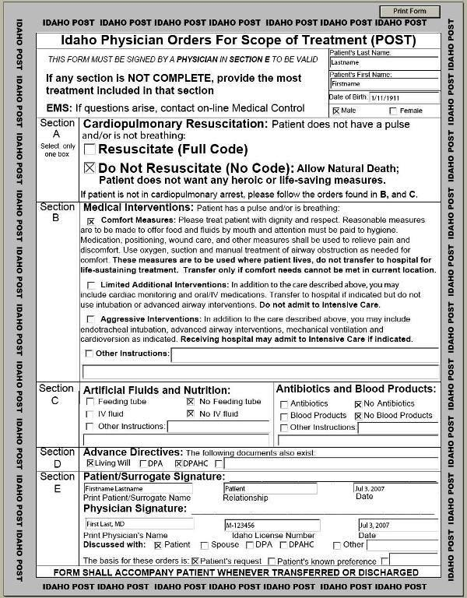
Physician Order for Scope of Treatment (POST)

Slide 59
POST
Form developed by DHW.
Standing order for CPR and artificial life-sustaining care signed by:
Physician, PA, or advanced practice professional nurse (“APPN”),
Patient or surrogate decision-maker, provided that surrogate cannot contradict the patient’s last known expressed wishes or directions.
(IC 39-4512A)
Designed to replace DNR and ComfortONE

Slide 60
Revocation of Advance Directive
Maker may revoke at anytime by:
Intentionally canceling, defacing, obliterating, burning, tearing, or otherwise destroying the document by maker or in maker’s presence and at maker’s direction.
Written revocation signed by maker.
Oral revocation by maker.
* What about other manifestation?
Maker is responsible for notifying provider.
Provider not liable for failing to act on revocation unless provider has actual knowledge of revocation.
(IC 39-4511A)

Slide 61
Suspension of Advance Directive
Advance directive is NOT automatically suspended during surgery.
Maker may suspend an advance directive at anytime by:
Written, signed suspension by maker expressing intent to suspend.
Oral expression by maker expressing intent to suspend.
* What about other manifestation?
Upon meeting the termination terms of the suspension as defined by the maker, the living will, DPOA, POST or other advance directive will resume.
(IC 39-4511B)

Slide 62
Immunity for Acting per Advance Directive
Providers and facilities are immune from liability if:
Provider acts in good faith pursuant to the directives in a facially valid advance directive.
If provider cannot assist due to conscience, provider makes good faith effort to help patient obtain services of another provider before withdrawing from care of patient.
Persons who exercise responsibilities of a DPOA in good faith are immune from liability.
(IC 39-4513)

Slide 63
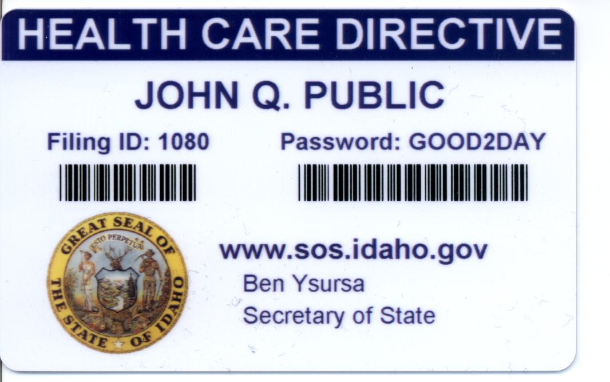
Idaho Health Care Directive Registry
Patient may register advance directive in the Idaho Health Care Directive Registry at www.sos.idaho.gov/general/hcdr.htm.
Providers may, but are not required to, check registry.

Slide 64
Advance Directives
Remember:
Living wills, DPOAs, and POSTs are not the only means of effective communication of patient wishes.
Any authentic expression of a person's wishes with respect to health care should be honored.
(IC 39-4509(3))
This section shall be liberally construed to give the effect to any authentic expression of the person's prior wishes or directives concerning his or her health care.
(IC 39-4514(7))

Slide 65
Questions?
Melissa M. Starry
mmstarry@hollandhart.com
208-383-3984
Kim C. Stanger
kcstanger@hollandhart.com
208-383-3913

