Slide 1
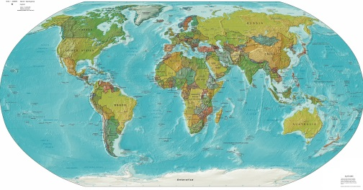

U.S. Export Controls
How to Comply with Commercial, Dual-Use, and
and Defense Article Regulations and U.S. Trade Sanctions
U.S. Trade Sanctions Compliance
May 11, 2016
Copyright Holland & Hart LLP 2016. All Rights Reserved.

Slide 2
Disclaimer
  This presentation, related materials and subsequent discussion are provided for educational purposes only. They do not constitute legal advice nor do they necessarily reflect the views of Holland & Hart LLP or any of its attorneys other than the speaker. This presentation is not intended to create an attorney-client relationship between you and Holland & Hart LLP. If you have specific questions as to the application of the law to your activities, you should seek the advice of your legal counsel.

Slide 3
AGENDA
Introductions
EAR / ITAR Overview
Licensing and Commodity Jurisdiction
OFAC Compliance
Lunch Keynotes
  Economic Espionage and Theft of Trade Secrets
  Export Regulations Enforcement
Export Control Reform Initiative Update
ITAR Registration Requirements (Including ITAR Part 129 Brokering)
Export Controls Compliance Programs (Including Key Lists to Check) and Voluntary Disclosures

Slide 4
WHY SHOULD YOU CARE ABOUT U.S. TRADE SANCTIONS?
Many countries have trade control laws that regulate international conduct
The United States trade control laws not only impact U.S. companies; they have extraterritorial application
Penalties can be assessed by the U.S. Government against both U.S. and non-US companies that violate U.S. trade laws (including monetary fines, loss of access to the U.S. commercial and financial markets and other penalties)

Slide 5
U.S. TRADE SANCTIONS
LAWS IN GENERAL
With whom do we conduct business?
What type of international transactions do we conduct (exports, foreign investments, sales, acquisitions or financial dealings)?
Where do we conduct this business?
How can we empirically demonstrate compliance?

Slide 6

KEY LEGAL CONCERNS
Trade Controls Laws (with whom we conduct business)
    U.S. Blocked Party Lists
    Country embargoes and sanctions
    United Nations Security Council Sanctions (restrictions on countries and individuals)
    Foreign country or territory sanctions (EU, individual country sanctions)

Slide 7

U.S. TRADE SANCTIONS LAWS
Summary - The Office of Foreign Assets Control (OFAC) is part of the U.S. Department of Treasury. It enforces U.S. economic sanctions against specific countries, as well against individuals and companies
Global Reach - OFAC also imposes restrictions on U.S. persons working globally and prevents these persons from facilitating or approving transactions that would be prohibited if performed in the U.S.

Slide 8
OFAC: JURISDICTION
OFAC sanctions apply to:
  U.S. citizens and permanent residents wherever located
  Persons, even if visa holders, located in the U.S.
  Persons engaging in transactions that involve property in or otherwise subject to the jurisdiction of the U.S.

Slide 9
OFAC: JURISDICTION (Cont.)
Extended Jurisdiction - If OFAC determines a non-U.S. party is violating OFAC sanctions:
  OFAC can place that party on the Specially Designated Nationals List and preclude it from doing business with any U.S. party (banks, for example) and a majority of the international community

Slide 10
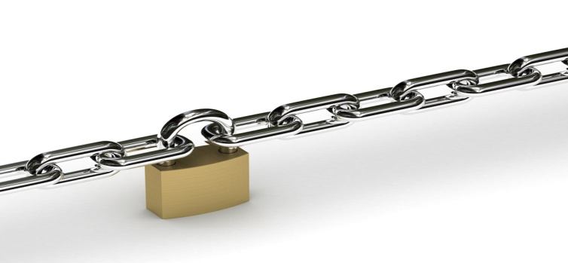
OFAC: COUNTRY SANCTIONS
Country Sanctions
  OFAC administers U.S. trade sanctions on select countries
  These sanctions bar or restrict trade activity by U.S. individuals or companies

Slide 11
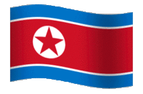
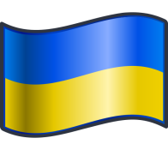
OFAC: COUNTRY SANCTIONS
Main Embargoed Countries
But what about and ?
Each embargo regime is different
Embargoes change as U.S. foreign policy evolves

Slide 12
OFAC: COUNTRY SANCTIONS
Other countries subject to OFAC targeted sanctions include:
  Balkans
  Belarus
  Burma
  Cote d’Ivoire
  Democratic Republic of the Congo
  Iraq
  Lebanon
  Liberia
  Libya
  North Korea
  Somalia
  Yemen
  Zimbabwe

Slide 13
OFAC: CUBAN SANCTIONS
U.S. trade embargo in effect since 1963 - Cuba is not fully opened for U.S. business
  Executive Action – Most recent on March 16, 2016
  Congressional Action Required
Export, investments, facilitation restrictions remain
General licenses
  Tourist travel not authorized
  But Individual People-to-People

Slide 14
OFAC: CUBAN SANCTIONS
Other transactions that are authorized under the sanctions include:
  Certain financial transactions
  Export of informational materials
  Internet services
  Provision of certain telecommunications services
    Does not generally include the export of equipment.

Slide 15
OFAC: IRANIAN SANCTIONS
Implemented in 1987. List of sanctions is growing with new laws and regulations
The sanctions contain many prohibitions, including:
  Prohibited conduct includes direct or indirect investments, trade or other conduct when a U.S. party, bank or other entity is involved
  Exports to and imports from Iran are prohibited
Joint Comprehensive Plan of Action implemented January 16, 2016
  Only certain sanctions lifted
General License H

Slide 16
OFAC: IRANIAN SANCTIONS
General Policy of Denial for Specific Licenses, except:
  Export of medicines, medical devices and agricultural products
  Case by case basis, for example:
    NGOs engaged in activities for the benefit of the Iranian people
    Medical services
    Educational and cultural activities
    Environmental projects
    Payment of legal fees (blocked funds, parties)

Slide 17
OFAC: SUDANESE SANCTIONS
Implemented in 1997 and expanded since by Executive Orders
The sanctions contain many prohibitions, including:
  Prohibited conduct includes direct or indirect investments, trade or other conduct when a U.S. party, bank or other entity is involved
    Certain exceptions apply – e.g., non-commercial remittances through non-Sudanese government-owned banks
  Exports to and imports from Sudan are prohibited
South Sudan ≠ Sudan

Slide 18
OFAC: SYRIAN SANCTIONS
Implemented in 2004 and continuously expanded through Executive Orders
Until August 18, 2011, generally prohibited exports of U.S. goods and conducting business with blocked parties
Current sanctions against Syria also prohibit:
  New investment in Syria by U.S. persons
  Facilitation by U.S. persons (i.e., services)
  Financial transactions, trade or other conduct when a U.S. party, bank or other entity is involved
  Exports to and imports from Syria

Slide 19
OFAC: OTHER SANCTION PROGRAMS
North Korean Sanctions
  Prohibit import of goods, technology and services from North Korea without a license
  Transactions with blocked parties
    Export only if transactions with blocked parties
Crimea
  Prohibit virtually all direct and indirect transactions by U.S. persons originating in or to Crimea
  Not a country – Region of Ukraine
Burma (Myanmar)
  General licenses now authorizes importation of Burma-origin goods and authorizing the export and re-export of financial services and new investment in Burma

Slide 20
OFAC: PROHIBITED PARTIES
U.S. Blocked Parties
  Specially Designated Nationals List (“SDNL”) Individuals on the blocked party registers are frequently “Specially Designated Nationals” or “SDNs”
  Foreign Sanctions Evaders Lists
  Sectoral Sanctions List
  Others
Other lists are maintained by the U.S. Departments of Commerce and State
Consolidated List: https://build.export.gov/main/ecr/eg_main_023148

Slide 21
OFAC: PENALTIES
Criminal Penalties (IEEPA) for violating the most OFAC regulations range up to 20 years in prison, and up to $1,000,000 in fines
  Cuban Sanctions (TWEA) – $1,000,000 / $100,000
Civil Penalties (IEEPA) up to $250,000 per violation
  Cuban Sanctions (TWEA) – $65,000
Transactions can be parsed to produce potentially multiple violations for each non-compliant transaction

Slide 22
OFAC: SPECIAL COMPLIANCE RISKS
Non-listed Sanctioned Parties
  Parties with an interest (e.g., ownership, control) in a blocked party
  Foreign ownership changes
Facilitation of a prohibited transaction
  Financing, legal/compliance support or counseling
Mandatory financial institution reporting (Suspicious Activity Reports)
Exceeding the scope of a General License or exemption

Slide 23

QUESTIONS

